Slide 1
INTERNATIONAL ORGANISATION FOR STANDARDISATION
ORGANISATION INTERNATIONALE DE NORMALISATION
ISO/IEC JTC1/SC29/WG11
CODING OF MOVING PICTURES AND AUDIO
ISO/IEC JTC1/SC29/WG11 MPEG2018/N18093
October 2018, Macau, China
Title | White paper on an Overview of the ISO Base Media File Format
Source | Communications
Editor | David Singer, Thomas Stockhammer

Slide 2

An Overview of the ISO Base Media File Format
… more then just a collection of Boxes
Reflecting the status in August 2018

Slide 3
Overview
Basics and History
Structures and Principles
More than just a paper spec – Tools and Deployments
ISO BMFF and streaming
Other recent application formats
Crystal Ball – What’s next?
Summary

Slide 4
Basics
The ISO Base Media File Format contains structural and media data information principally for timed presentations of media data such as audio, video, etc.
There is also support for un-timed data, such as meta-data.
By structuring files in different ways the same base specification can be used for files for
capture;
exchange and download, including incremental download and play;
local playback;
editing, composition, and lay-up;
streaming from streaming servers, and capturing streams to files.
ISO base media file format (MPEG-4 Part 12) also known as ISO BMFF
Developed by | ISO
Type of format | Media container
Container for | Audio, video, text, data
Extended from | QuickTime .mov
Extended to | MP4, 3GP, 3G2, .mj2, .dvb, .dcf, .m21, .cmf
Standard | ISO/IEC 14496-12, ISO/IEC 15444-12
Website | https://www.iso.org/standard/68960.html

Slide 5
History
ISO BMFF is directly based on Apple’s QuickTime container format.
It was developed by MPEG (ISO/IEC JTC1/SC29/WG11).
first MP4 file format specification was created on the basis of the QuickTime format specification published in 2001.
The MP4 file format known as "version 1" was published in 2001 as ISO/IEC 14496-1:2001, as revision of the MPEG-4 Part 1: Systems.
In 2003, the first version of MP4 file format was revised and replaced by MPEG-4 Part 14: MP4 file format (ISO/IEC 14496-14:2003), commonly known as MPEG-4 file format "version 2".[13]
The MP4 file format was generalized into the ISO Base Media File format (ISO/IEC 14496-12:2004 or ISO/IEC 15444-12:2004), which defines a general structure for time-based media files.

Slide 6
Spec Releases 14496-12
MPEG-4 Part 12 / JPEG 2000 Part 12 editions
Edition | Release date | Standard | Main Features
First edition | 2004 | ISO/IEC 14496-12:2004, ISO/IEC 15444-12:2004 | Initial base spec
Second edition | 2005 | ISO/IEC 14496-12:2005, ISO/IEC 15444-12:2005 | ???
Third edition | 2008 | ISO/IEC 14496-12:2008, ISO/IEC 15444-12:2008 | ???
Fourth edition | 2012 | ISO/IEC 14496-12:2012, ISO/IEC 15444-12:2012 | Font streams, subtracks and colors, DASH, reception hint tracks
Fifth edition | 2015 | ISO/IEC 14496-12:2015, ISO/IEC 15444-12:2015 | Timed text and better audio
Sixth edition | 2018 (expected) |  | DRC and HEIF
Supported by Amendments and Corrigendas

Slide 7

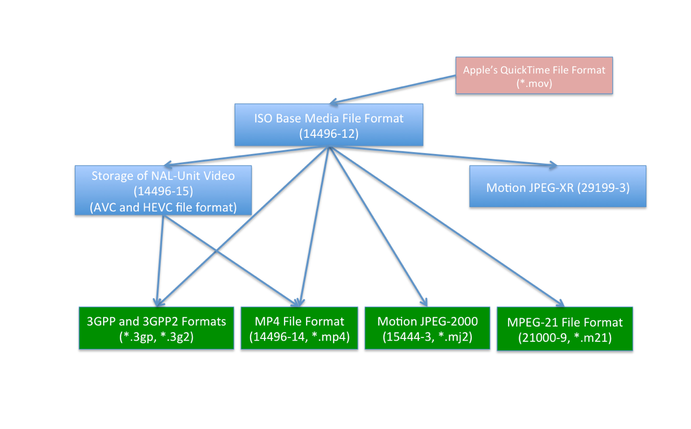

The Whole Suite
Timed text and other visual overlays in ISO base media file format
(14496-30)
Common encryption in ISO base media file format files
(23001-7)
CMAF
23000-19
DASH
23009-1
MMT
23008-1
OMAF
23090-2

Slide 8
Structures And PrincIples
Logical, Timing and Physical Structures

Slide 9
Basic Structures
The files have
a logical structure: a movie that in turn contains a set of time-parallel tracks.
a time structure: the tracks contain sequences of samples in time, and those sequences are mapped into the timeline of the overall movie by optional edit lists.
a physical structure; a series of boxes (sometimes called atoms), which have a size and a type.
These structures are not required to be coupled.

Slide 10
Logical Structures
Each media stream is contained in a track specialized for that media type (audio, video etc.), and is further parameterized by a sample entry.
The sample entry
contains the ‘name’ of the exact media type (i.e., the type of the decoder needed to decode the stream) and any parameterization of that decoder needed.
The name also takes the form of a four-character code.
There are defined sample entry formats not only for MPEG-4 media, but also for the media types used by other organizations using this file format family.
They are registered at the MP4 registration authority.
Tracks (or sub tracks) may be identified as alternatives to each other, and there is support for declarations to identify what aspect of the track can be used to determine which alternative to present, in the form of track selection data.

Slide 11
File
Track
Sample
Represents contiguous data used by a decoder at given times (DTS, CTS)
Item
Represents data consumed as a whole and valid for the entire duration of the movie,
Contains
timed data in tracks of a movie
Other data (untimed) in items
Or a combination of both
Defines a common timeline for all tracks to be synchronized
Corresponds to a specific media type (codec),
Is associated to a single decoder (except for scalable codecs),
May be linked, grouped or alternative to other tracks
May have associated untimed data in items
May be encrypted
Is decomposed into samples
Has properties (size, position, random access, decoder configuration…)
May be described in terms of sub-samples
May be associated to other similar samples in sample groups
May have sample-specific auxiliary information
Has properties (type, position, size …)
May be encrypted, compressed, …
meta data
media data
Item
Video information track 01
video & audio
samples
Movie
information
Audio information track 02

Slide 12
Physical Organization
Data is stored in a basic structure called box
No data outside of a box
Each box has length, type (4 printable chars), possibly version and flags, and data
Extensible format:
Unknown boxes can be skipped (syntactically)
Header information is a hierarchical set of boxes (typically ‘moov’ or ‘meta’)
Media data is stored unstructured, in boxes (mainly ‘mdat’, or ‘idat’) in the same file as the header or may be stored in a separate file

Slide 13
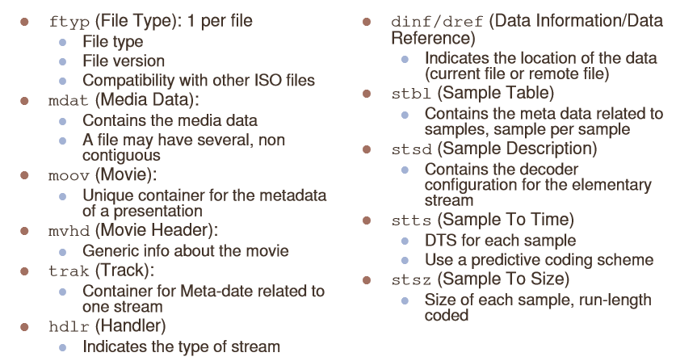
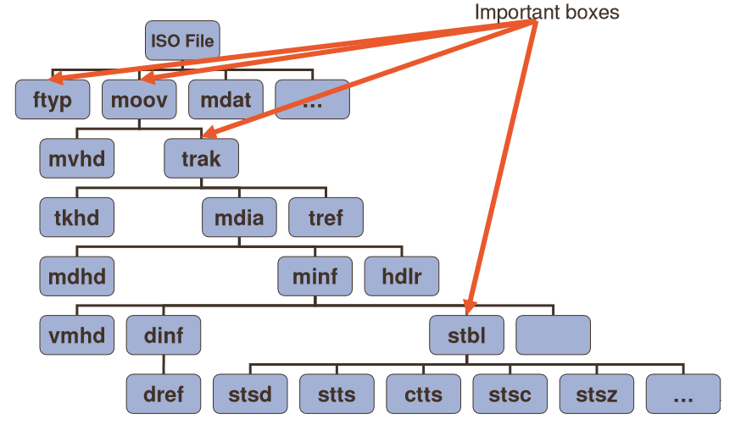
TyPical Structure

Slide 14
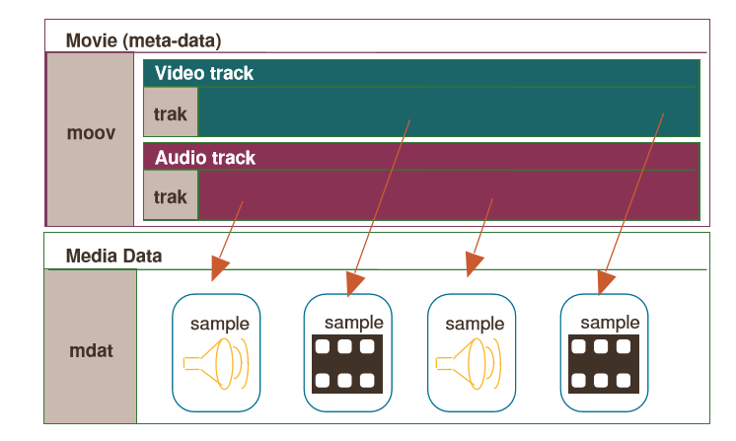
Example organization

Slide 15
Timing Organization
Each track is a sequence of timed samples;
each sample has a decoding time, and may also have a composition (display) time offset. Edit lists may be used to over-ride the implicit direct mapping of the media timeline, into the timeline of the overall movie.
Sometimes the samples within a track have different characteristics or need to be specially identified.
One of the most common and important characteristic is the synchronization point (often a video I-frame).
These points are identified by a special table in each track.
More generally, the nature of dependencies between track samples can also be documented.
Finally, there is a concept of named, parameterized sample groups.
Each sample in a track may be associated with a single group description of a given group type, and there may be many group types.

Slide 16
Decode, Composition and Movie Times
Segment | /-- | -- | -- | -- | -- | --\ | /- | -- | -- | -- | --- | --\
 | I3 | P1 | P2 | P6 | B4 | B5 | I9 | P7 | P8 | P12 | B10 | B11
Presentation Order | |==| P1 P2 I3 B4 B5 P6 |==| P7 P8 I9 B10 B11 P12 |==|
Base media decode time | 0 |  |  |  |  |  | 60
Decode Delta | 10 | 10 | 10 | 10 | 10 | 10 | 10 | 10 | 10 | 10 | 10 | 10
DT | 0 | 10 | 20 | 30 | 40 | 50 | 60 | 70 | 80 | 90 | 100 | 110
EPT | 10 |  |  |  |  |  | 70
Composition time offset | 30 | 0 | 0 | 30 | 0 | 0 | 30 | 0 | 0 | 30 | 0 | 0
CT | 30 | 10 | 20 | 60 | 40 | 50 | 90 | 70 | 80 | 120 | 100 | 110
ISO BMFF has three timelines
Decode times
Composition times
Movie/Presentation time
ISO BMFF provides
Decode deltas/times
Composition offsets (may be negative)
Edit Lists signaled in movie header
The presentation time for synchronized presentation is obtained as
DT + CO + EL
Segment | /-- | -- | -- | -- | -- | --\ | /- | -- | -- | -- | --- | --\
 | I3 | P1 | P2 | P6 | B4 | B5 | I9 | P7 | P8 | P12 | B10 | B11
Presentation Order | |==| P1 P2 I3 B4 B5 P6 |==| P7 P8 I9 B10 B11 P12 |==|
Base media decode time | 0 |  |  |  |  |  | 60
Decode Delta | 10 | 10 | 10 | 10 | 10 | 10 | 10 | 10 | 10 | 10 | 10 | 10
DT | 0 | 10 | 20 | 30 | 40 | 50 | 60 | 70 | 80 | 90 | 100 | 110
EPT | 0 |  |  |  |  |  | 60
Composition offset | 20 | -10 | -10 | 20 | -10 | -10 | 20 | -10 | -10 | 20 | -10 | -10
CT | 20 | 0 | 10 | 50 | 30 | 40 | 80 | 60 | 70 | 110 | 90 | 100

Slide 17
Metadata – TWO FORMS
First, timed meta-data may be stored in an appropriate track, synchronized as desired with the media data it is describing.
See for example for 23001-10 for timed metadata, e.g. Region of interest, location, etc.
support for non-timed collections of metadata items attached to the movie or to an individual track.
The actual data of these items may be in the metadata box, elsewhere in the same file, in another file, or constructed from other items.
these resources may be named, stored in extents, and may be protected.
These metadata containers are used in the support for file-delivery streaming, to store both the ‘files’ that are to be streamed, and also support information such as reservoirs of pre-calculated forward error-correcting (FEC) codes (e.g. hint tracks)
The generalized meta-data structures may also be used at the file level,
above or parallel with or in the absence of the movie box.
In this case, the meta-data box is the primary entry into the presentation.

Slide 18
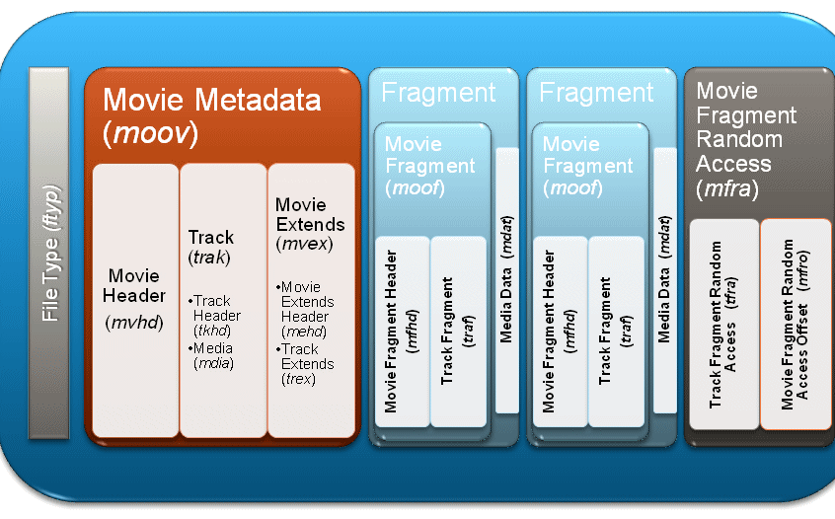
Fragmented movies
© Microsoft

Slide 19
Extensibility
Simple extensions:
New codec for temporal data for which you own the sample format (e.g. AV1 in MP4)
New sample groups for (codec-specific) annotation of samples (e.g. HEVC CRA/BLA)
New sample auxiliary data , for (codec-specific) per-sample data (e.g. init vector, …)
New untimed data format (e.g. EXIF, XMPP …)
New user-, vendor-specific data (use ‘meta’, ‘udta’, ‘free’, ‘skip’, or ‘uuid’ boxes)
Harder extensions
Beware of backwards compatibility !
Only if all other options have been exhausted
Extending existing boxes: Use versioning and/or flags
New boxes (almost always the wrong option!)
Check for name clashes (www.mp4ra.org)
Define box syntax and semantics
Choose box location and cardinality
Timed/Untimed information
File level, segment level, movie level, track level, sample level, …
Define new brand if it implies behavior changes/incompatibilities

Slide 20
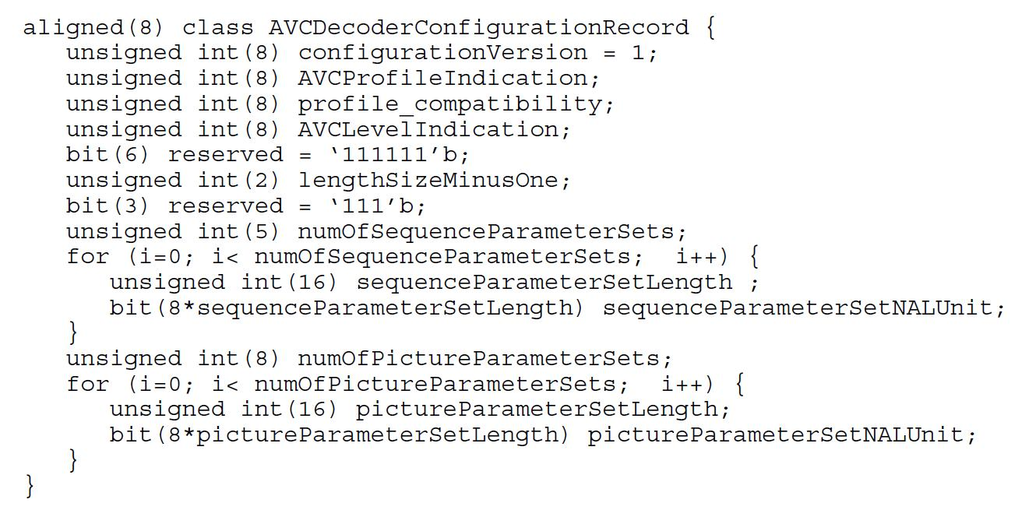

MPEG Video in Isobmff (14496-15)
Carriage of network abstraction layer (NAL) unit structured video in the ISO base media file format
Defines not only what a sample is, but also has various options
Parameter sets in the sample entry (initialization), or in-stream
Out-of-band mechanism: identified by the use of ‘avc1’ or ‘hvc1’
Inband parameter sets: identified by ‘avc3’ or ‘hev1’
Sample groups to describe samples (random access etc.)
Defines carriage of both scalable and multi-view extensions to AVC & HEVC
Single-track or multi-track
Sample groups etc. to help choose which track(s) to consume

Slide 21
Other Media
Audio:
'mp4a‘ defines the set of MPEG-4 audio in the MP4 spec 14496-14
Other audio technologies define the sample entry and track mapping in their media specs
Subtitles
IMSC1 and WebVTT see 14496-30
External media can be added to the ISO BMFF as well
The codecs parameter is defined in RFC6381
The 'Codecs' and 'Profiles' Parameters for "Bucket" Media Types
Permits signaling sample entries plus additional information
Currently under discussion – how much needs to be there for capability

Slide 22
Common Encryption 23001-7
Movie Box (‘moov’)
specifies elementary stream encryption and encryption parameter storage to enable a single ISO Media file that support different Digital Rights Management systems (DRM) to manage keys and securely decrypt the media.
Clear and encrypted byte ranges are identified in the track metadata as “subsamples”
First edition: ‘cenc’ - single encryption scheme using AES-128 counter mode cipher
Second edition: ‘cbc1’ using AES-128 with Cipher Block Chaining mode (CBC)
Third edition: two pattern encryption schemes, identified as ‘cbcs’ and ‘cens’
Protection Specific Header Box(‘pssh’)
Container for individual track (‘trak’) x [# tracks] …
Container for media information in track (‘mdia’)
Media Information Container (‘minf’)
Sample table box, container of the time / space map (‘stbl’)
Protection Scheme Information Box (‘sinf’)
Scheme Type Box (‘schm’)
Scheme Information Box (‘schm’)
Track Encryption Box (‘tenc’)

Slide 23
More than Just A Paper Spec
Tools and Software

Slide 24
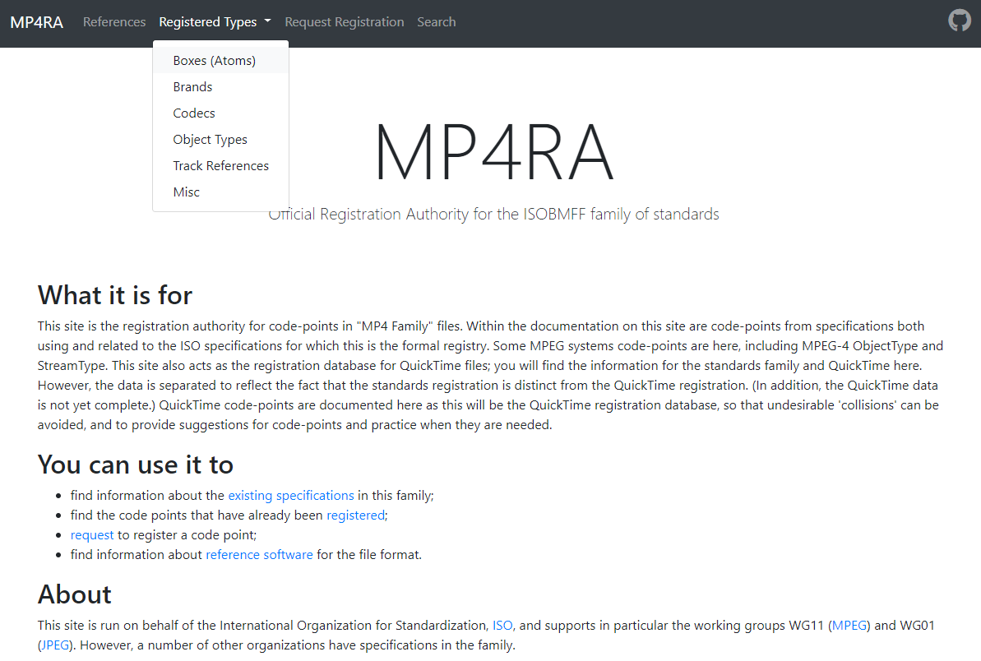
MPEG‘s SupportING Tools
Conformance bit streams
ISO/IEC 14496-4
Some streams are freely available
http://standards.iso.org/ittf/PubliclyAvailableStandards/
More are welcome
Software
ISO/IEC 14496-5
Reference software, freely available
C, ISO Licence
Read/Write MP4 files
Contributions are welcome
MP4 Registration Authority http://www.mp4ra.org
There is a registration authority which registers and documents the four-character-code code-points used in this file-format family, as well as some other code-points related to MPEG-4 systems.
The database is publicly viewable and registration is free.

Slide 25
Open Source and Commercial Services
Open Source
Widely implemented in open source, e.g. FFMpeg, MP4Box
Nokia Labs even has a Javascript implementation
Usage in Commercial Services
tbd
Check here: http://mp4ra.org/#/brands

Slide 26
ISOBMFF and Streaming
DASH and CMAF

Slide 27



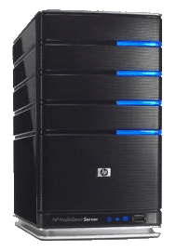

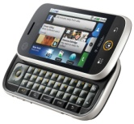
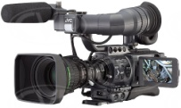

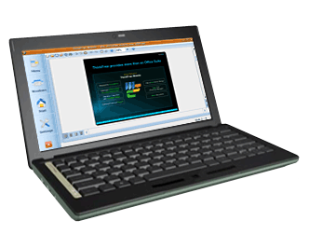
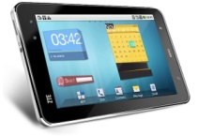
Adaptive Streaming
Encode each video at multiple bitrates
Make each segment addressable via an
HTTP-URL
Client makes decision on which segment to download
Client acquires a license for encrypted content
1
4
5
6
2
Split the videos into small segments
Client splices together and plays back
7
001010100001010
010101010001110
01110100011010101
001010100001010
010101010001110
01110100011010101
001010100001010
010101010001110
01110100011010101
001010100001010
010101010001110
01110100011010101
3
Encrypt each segment
Media Capture
and Encoding
DRM Encryption
Server
Media
Origin
Servers
HTTP
Cache
Servers
Client
Devices
DRM
License
Server
© Microsoft

Slide 28
Why the File Format for Streaming?
Object Oriented – flexible and extensible structures called “boxes” used for sequencing media data along with nested metadata allowed specification of independently decodable “movie fragments” (DASH “Segments”)
Extensible metadata model – that allowed adding information for live streaming, encryption, subtitles, new codecs, etc., separate from media data
Extensible timing model – presentation time is the sum of previous sample durations, allowing time to be calculated on playback … not a timestamp recorded on each sample
Interoperable file “brands” – identifying sets of new boxes that enable adaptive streaming, Common Encryption, new codecs, live streaming, etc. with well-defined interoperability
Enabled creation of a Multimedia Presentation Application Model consisting of a Media Object Model and Media Timeline Model that support late binding of adaptive multimedia presentations with a single set of media objects enabling a variety of delivery methods, such as file download, track download, multicast/broadcast, and adaptive streaming

Slide 29
Example DASH Representation and Segments for ISOBMFF
ftyp
moov
moof
mdat
moof
mdat
moof
mdat
moof
mdat
Initialization Segment
Media Segment
Media Segment
Representation

Slide 30
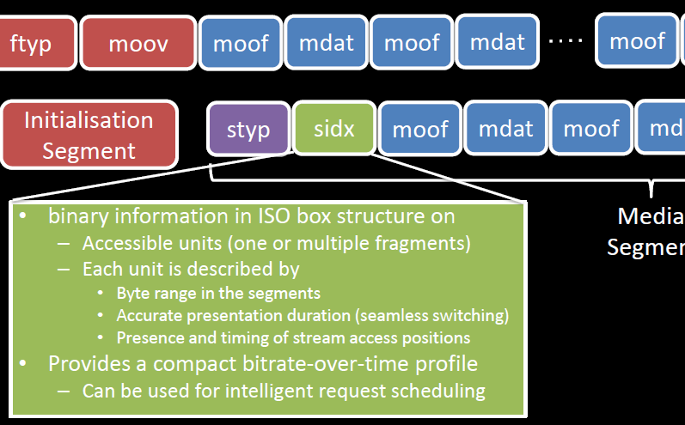
Segment Index

Slide 31
Late Binding
To avoid combinatorial complexity or useless downloads, tracks are offered individually on cloud
Client selects relevant tracks and synchronizes playout
English AAC stereo CMAF Switching Set (single Track)
Audio Selection Set
French AAC stereo CMAF Switching Set (single Track)
English multichannel CMAF Switching Set (single Track)
French multichannel CMAF Switching Set (single Track)
English WebVTT description CMAF Switching Set (single Track)
Subtitle Selection Set
English TTML description CMAF Switching Set (single Track)
French WebVTT dub CMAF Switching Set (single Track)
French TTML dub CMAF Switching Set (single Track)
SD Media Profile CMAF Switching Set (multiple Tracks)
Video Selection Set
HD Media Profile CMAF Switching Set (multiple Tracks)
UHD10 Media Profile CMAF Switching Set (multiple Tracks)

Slide 32
Events
Providing the ability that an application can distribute media synchronized events such as SCTE markers, simple overlays, stats, etc.
Application
DASH Client control, selection & heuristic logic
Event Processing
App Event
dispatch
HTTP stack
API
Media Decoder
Segment Parsing
Media decoder input buffer
HTTP
stack
Industry current working on a consistent support for Events

Slide 33
Low latency Streaming
MPD
Encoder
IS
CNC
CNC
CIC
CNC
CNC
CIC
CH
DASH Packager
DASH Segment
HTTP Chunk
HTTP Chunk
CH = CMAF Header
CNC
CNC
CIC
CNC
CNC
CIC
CNC = CMAF non-initial chunk
CIC = CMAF initial chunk
10s
Regular
DASH Client
Segments
CDN stores Segments
More Tomorrow
3s
Low-Latency
DASH Client
Chunks

Slide 34
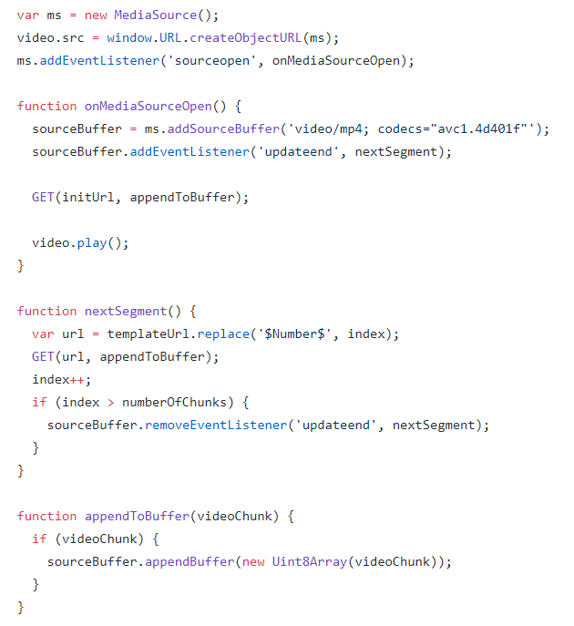
MSE and bytestream Format
Media Source Extension (MSE)
This specification extends HTMLMediaElement [HTML51] to allow JavaScript to generate media streams for playback.
Allowing JavaScript to generate streams facilitates a variety of use cases like adaptive streaming and time shifting live streams.
ByteStream Format for ISO BMFF
https://www.w3.org/TR/mse-byte-stream-format-isobmff/
This specification defines a Media Source Extensions™ [MEDIA-SOURCE] byte stream format specification based on the ISO Base Media File Format.

Slide 35
Other APplications

Slide 36
High Efficiency Image File Format
ISO/IEC 23008-12 permits storage:
Sequences (e.g. bursts, brackets): as tracks, MP4-style
Images (coded or derived) as Items, MPEG-21-style
Coded Items
HEVC, AVC, JPEG, (JPEG-XR),…
Derived items
Image overlay (compose)
Image Grid
…
Metadata Items
EXiF, XMP, MPEG-7, …
pqrs
properties
initialization
🔒
cdsc
visual size
abcd
mirror
jpeg
dimg
jpeg
Primary Item

Slide 37
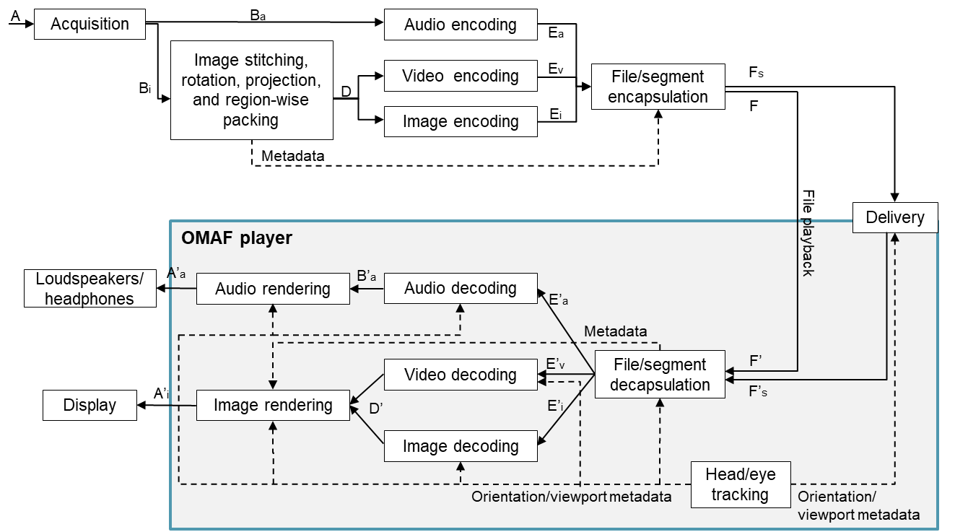
Omnidirectional Media Format (OMAF)
23090-2: Part 2 of MPEG-I Coded Representation of Immersive Media
It is a systems standard developed by MPEG that defines a media format, enables omnidirectional media applications, focusing on 360° video, images, and audio, as well as associated timed text.

Slide 38
OMAF Signaling in ISO BMFF
General rules for signalling of important information
Overall omnidirectional video indication
Signalling of projection format
Signalling of region-wise packing and guard bands
Signalling of rotation
Signalling of frame packing
Signalling of content coverage
Region-wise quality ranking
Signalling of fisheye video parameters
Storage and signalling of omnidirectional images
Storage and signalling of timed text
OMAF timed metadata

Slide 39
Partial file Format 23001-14
The Partial File Format is designed to contain files partially received over a lossy link (with unreceived or corrupted sections), for further processing such as playback or repair.
The file structure is object-oriented; a file can be decomposed into constituent objects very simply, and the structure of the objects inferred directly from their type.
This format contains the correctly received data, missing block identification, and repair information such as location of the file or high-level original indexing information.

Slide 40
Crystal Ball
Some MPEG Activities

Slide 41
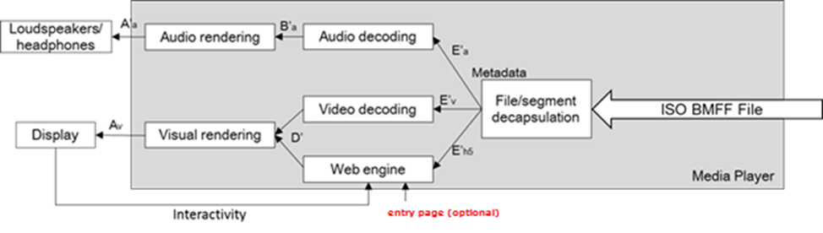
Web resource Track 23001-15
Under development
specifies how the ISO BMFF format can be used to store web resources (e.g. HTML, JavaScript, CSS, …)
specifies hypothetical processing for how these files can be consumed by web browsers, in particular how references from web resources to the file that carry them or to other web resources carried in the same file are handled.
enables the delivery of synchronized media and web resources as supported by ISO/IEC 14496-12: file download, progressive download, streaming, broadcast, etc.
Workshop planned with 3GPP, MPEG, W3C, ATSC, DVB, CTA and HbbTV

Slide 42
Immersive Media in ISO BMFF
Examples
Tiled 360 videos in very high resolution
Large Point Clouds that can be navigated in 6 DoF
Lightfields with lots and lots of small tiles
A complicated Scene Graph with many objects to traverse
Audio objects can be audible, or beyond the “audio horizon” in an immersive experience
Environment
All likely retrieved from some sort of cloud infrastructure
All of these can be available in multiple quality/bitrate variations
At the receiver all of those need to decoded and decrypted with constrained devices
Server/Cloud
Client
VR App/DASH Client
Decoding
Rendering

Slide 43
Immersive Cloud Media
Media Resource References
Timing Information
Spatial Information
Media consumption information
Presentation Engine
Sync Information
Shader Information
Manifest, Index, …
Decoder
Texture Buffer #1
Cloud
Protocol Plugin
Media
Retrieval
Engine
Texture Buffer #2
Format Plugin
Media Requests
Decoder
Vertex Buffer #1
Decoder
Texture Buffer #n
Local Storage
Vertex Buffer #n
MPEG is currently investigating storage and streaming formats for immersive media
Shader Buffer
Audio Decoder
Sync
Rendering

Slide 44
Challenges
Flexibly retrieving parts of a large body of media data from a cloud resource to create a coherent user experience under constrained resources
Where constraints exist like bandwidth, access latency, decode resources (and where these can fluctuate dynamically)
With the client in charge of making trade-offs given such constraints
Where fast response times and efficiency are crucial for the QoE
Where inherently, data is accessed and retrieved in multiple parallel streams
Where this data may need to be protected and/or encrypted
Where this data may need to be cached close to the user for the best experience
Where the data is stored in the cloud in a distributed manner

Slide 45
Organization Dimensions: Immersive Media
Temporal random access – “as usual”
Spatial random access – retrieving only the relevant parts of the media
Depending on user orientation
Making quality/bitrate trade-offs in switching between quality levels
Depending on what is visible/audible
Depending on retrieval/device and resource constraints, including bandwidth, latency, decoder capability, things like video and audio reproduction capabilities (e.g. screen resolution and color space; speaker config)
Decoding capabilities, user preferences, etc.
Addition of static media
Different timelines
Scene Descriptions, Nodes, etc.
Which objects to retrieve – and which parts of objects
Extend the File Format or do something “NEW”? ➔ ongoing

Slide 46
Summary

Slide 47
Summary
Successful file format
Very versatile: from editing to HTTP streaming to broadcasting
Very extensible (codecs, usages, applications)
Very dynamic (more contributions than ever)
Some challenges
Carrying some legacy that is no longer in use
Addressing all the use cases while maintain compatibility
For certain applications and use cases, the file format principles are suboptimal in terms of overhead or processing efficiency.
The ISO BMFF is the stable glue between modern media and transport, but will evolve further for new use cases applications.

Slide 48


Thank You
Thanks to Dave Singer, Kilroy Hughes, Per Fröjdh, Cyril Concolato, Ye-Kui Wang, Iraj Sodagar, Jean Le Feuvre and other contributors to the presentation

